Slide 1

Startup companies
Exploratory Data Analysis
Hassan Al Hashimi
DSB-3

Slide 2
Objective
why majority of startups with percentage of 58.6% start in USA? how does it vary by country to another?
32.4% of startups are in California state
7% of them are in New York City

Slide 3
Key Terms
ROI: Return of Investment
Total funding: Total amount of funding raised by the company across all rounds,
in US dollars
Angel Investors: investor who finance a business or startups, usually in exchange for or ownership equity or debt.

Slide 4
Quantitative Analysis

Slide 5
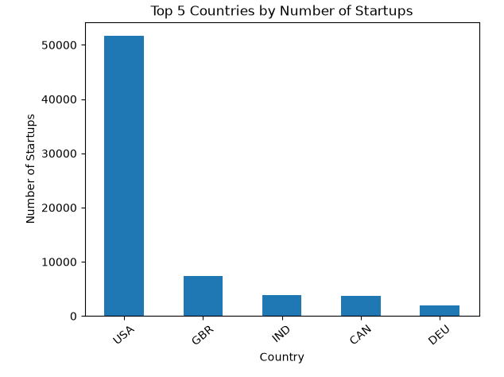

Slide 6
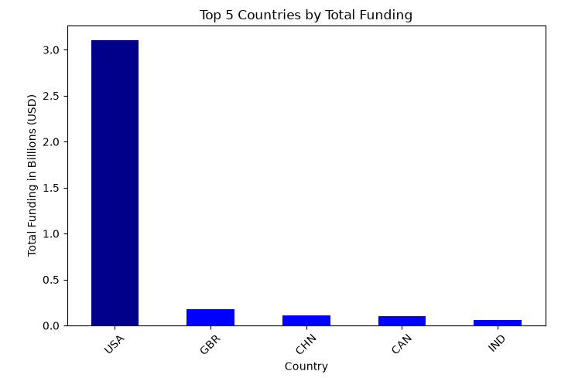

Slide 7
Remarkable numbers in USA
high funding reaching 33% worldwide
highest ROI 13333.33 USD

Slide 8
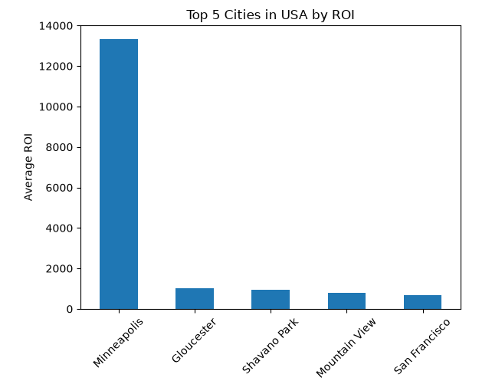

Slide 9
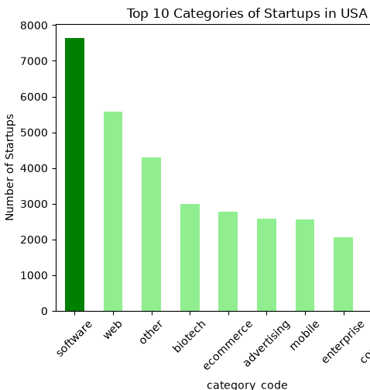
16% of startups in USA are in software

Slide 10
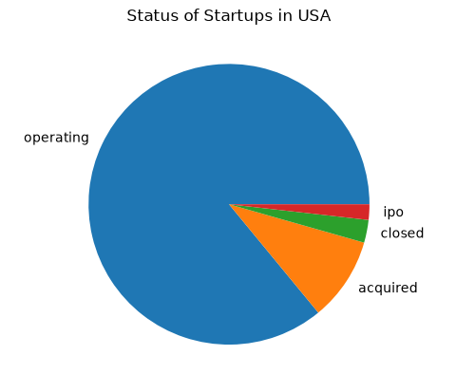
operating 85.9% acquired 9.6% closed 2.6% ipo 1.7%

Slide 11
Qualitative Analysis
venture capital firms, angel investors
Supportive Infrastructure and Resources
Government Policies and Regulations
Intellectual Property Protection

Slide 12
Startups in USA vs Europe
Labor Laws
Financing and Venture Capital
Education & Talent
Culture and Consumers

Slide 13
Conclusion
Based on qualitative and quantitative analysis the chance of success of startup in USA is high
Results shows remarkable profit generated from startups in USA

Slide 14
Recommendations
Entrepreneurs are recommended to establish a startup in USA
Investors should invest and acquire startups

Slide 15
Next Steps
More Research
More Data Auditing
Increasing Accuracy in EDA

Slide 16
Resources
https://www23.statcan.gc.ca/imdb/p3VD.pl?Function=getVD&TVD=53971
Entrepreneurism in Europe vs U.S.: Why the “American Dream” is Still Best — Mount Bonnell Advisors

